Slide 1
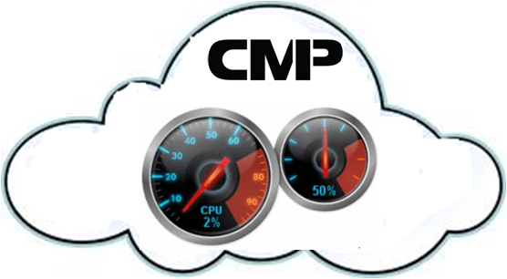
CLOUD MANAGEMENT PLATFORM

Slide 2
What is Cloud Computing?
National Institute of Standards and technology (NIST) defines cloud computing as “a model for enabling convenient, on-demand network access to a shared pool of configurable computing resources (e.g., networks, servers, storage, applications, and services) that can be rapidly provisioned and released with minimal management effort or service provider interaction”.

Slide 3
Why the name Cloud ?
Physical Infrastructure remaining opaque
Access to the computer resources without knowing its physical location
Resources appear to the User as being “In The cloud”

Slide 4
Why the shift?
Consider task of managing emails
Hosted Software (Microsoft Exchange Server)
Huge Upfront cost , skills, software license, everyday hassles
The Cloud (Google mail)
Predictable monthly fee , no hassles, easy to use

Slide 5
PROS of CLOUD COMPUTING?
Low Setup Cost
More Scalable
More Reliable
Regular Upgrading
Ubiquitous Access

Slide 6
TYPES OF CLOUD
Public
Private
Hybrid
Advantages of Private Cloud
Easy Migration
Secure

Slide 7
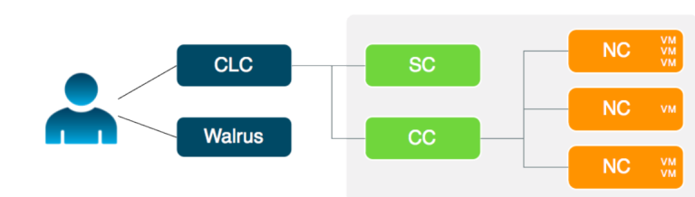
EUCALYPTUS
Comprised of Six Components
Cloud Controller (CLC)
Walrus
Cluster Controller (CC)
Storage Controller (SC)
Node Controller (NC)
VMware Broker
Eucalyptus architecture

Slide 8
Problem Statement
Eucalyptus private cloud lacks a User Interface
Client’s total dependence on the Administrator
Need of Administrator 24*7
Low number of users because of the complexity
Slow Processing during Peak Load

Slide 9
SYSTEM ARCHITECTURE DESIGN
Cloud Controller
Node Controller
Connects cloud Using
Graphical User Interface
Instances

Slide 10
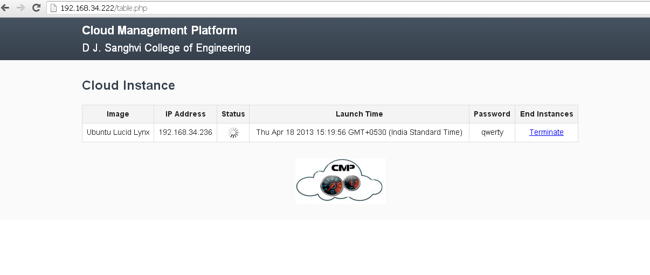
PROPOSED SYSTEM
User friendly
Time redemptive and Access on the go
Minimized Human Intervention

Slide 11
Performance Monitoring
Low Slow time
Optimum Resource Utilization
Performance Parameters
Linux commands like htop and iptraf

Slide 12
CONCLUSION AND FUTURE SCOPE
Eucalyptus Private Cloud
Components
Architecture
Drawbacks
CMP-shields the client from the complicated private cloud architecture
Finding out parameters that affect the performance
Making a database of all the performance parameters
Apply associative data mining technique
Decide threshold based upon the analysis

Slide 13
REQUIREMENTS
Compute Requirements
Physical Machines: All Eucalyptus components must be installed on physical machines, not virtual machines.
Central Processing Units (CPUs): It is recommended that each machine in your Eucalyptus cloud contain either an Intel or AMD processor with a minimum of two, 2GHz cores.
Operating Systems: Eucalyptus supports the following Linux distributions: CentOS 5 (5.6 and above), CentOS 6, RHEL 5 (5.6 above), RHEL 6, Ubuntu 10.04 LTS, Ubuntu 11.04 Natty Version, and Ubuntu 12.04 LTS.
Storage and Memory Requirements
Each machine in your network needs a minimum of 30 GB of storage.
We recommend at least 100GB for Walrus and SC hosts running Linux VMs. It is recommended at least 250GB for Walrus and SC hosts running Windows VMs.
Network Requirements
All NCs must have access to a minimum of 1Gb Ethernet network connectivity.
All Eucalyptus components must have at least one Network Interface Card (NIC) for a base-line deployment.
Apart from these requirements, we also require a public IP for cloud and Internet access to make our GUI ubiquitously accessible.

Slide 14
THANK YOU

